Slide 1
Making sense of it all
analysing and interpreting data

Slide 2
From data to ideas to arguments
How will you define your data?
What ‘is’ it? What kind of data are you using, and what is it data of or about?
How are you collecting your data?
What strategies are you using to gather information and insight, and why?
How are you organising your data?
Are you grouping things, keeping separate folders, keeping track of themes?
How will you analyse your data?
What methods will you use to classify and find patterns and meanings?
(e.g., coding, mapping, statistical operations, dialogues, triangulating…)
How will you interpret your data?
What story can you tell from this analysis; how will you use it to answer your questions?

Slide 3
Analysis, synthesis & interpretation
Analyse – to deconstruct something that seems coherent into smaller parts in order to make alternative sense of it
Greek: analyein (‘unloose, release, set free’ – ‘ana’ [up] + lyein [unfasten])
Synthesise – to put dispersed things or ideas together in order to make alternative sense of them in relation to each other
Greek :synthesis (‘put together’ – ‘syn’ [together] + ‘tithenai’ [put, place])
Interpret – to produce meaning for something or set of things that is not given or immediately self-evident

Slide 4
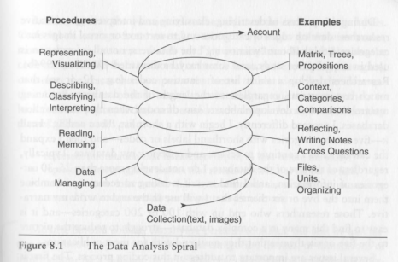
Working with your data
Read through (or immerse in) transcripts / field notes / data sets / texts to ‘get a feel’
Categorise and code significant text
Thematise coded text and refine categories
Explore relations between codes; develop higher-order codes; theorise
Cresswell (2007)
The aim is to ‘articulate the knowledge you have generated, how it has affected your practice and what significance it may have for other practitioners. Here you are building personal theories based on what you have done.’ (Koshy 2010, p. 119)

Slide 5
Using statistical data in action research
Do you need statistical information in your project? If so, what role does it play in relation to your action?
Are you dealing with descriptive or inferential statistics?
‘Pupil Premium struggling to close GSCE attainment gap’
‘Positive signs on the Pupil Premium effect’
Demos dataset
How will you use indicators of phenomena to measure constructs of things you want to know about, and how will you interpret this data?

Slide 6
Analysing interviews and observations
Find patterns in content (content analysis). Analyse how often certain things are said or concepts appear, by whom, in what context, etc.
Look for patterns in meaning (pattern coding). For example, how do different people express their understandings of a common experience across interviews, or how are themes connected within single interviews? Are there connections, tensions, surprises?
Look for the most important themes across all data (focused coding) – once you’ve coded things, dig into all the particular themes to see if there is anything that ties them together.
Identify key themes that speak to all your data (axial coding). Review all the data and try to find the bigger categories into which they all might fit.
Identify theoretical concepts or frameworks that help you explain why your data looks the way it does, or what is going on within it (theoretical coding).

Slide 7
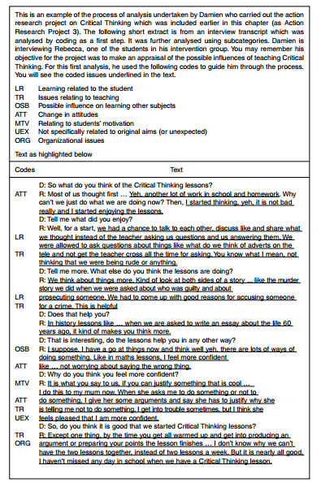

Slide 8
Triangulating data, methods, researchers
Different methods can reveal different dimensions of a phenomenon, and can bring out different voices and perspectives (towards ‘holism’ and ‘complexity’)
Different types of data can either validate certain conclusions or reveal where a ‘finding’ is limited or particularly contextual (towards ‘objectivity’)
Different researchers analyse research data through different lenses, and can highlight differences of interpretation or come to a consensus conclusion

Slide 9
Speaking truth?
The purpose of action research is personal and social improvement or emancipation, and the approach does not claim to be ‘scientific’. On what grounds can we make claims to know anything?
Social research is evaluated on the basis of specific criteria, which differ across traditions (paradigms)
scientific/positivist, interpretive and action research epistemologies have some different criteria for judging whether research is sound and robust

Slide 10
Criteria for validation of action research
‘Validation’ rather than ‘validity’ – the effectiveness of the research in improving the conditions in question, opening new possibilities for change, generating questions and new ways of thinking, facilitating dialogue about the problem, democratising relationships, improving learning
‘Trustworthy’ – credible and rigorous, dependable, confirmable, transferable (made possible when a researcher is reflexive about choices, justifies decisions, makes process of thinking clear)
‘Significant’ – is of use in helping someone or a group of people understand and gain agency in their situation

Slide 12
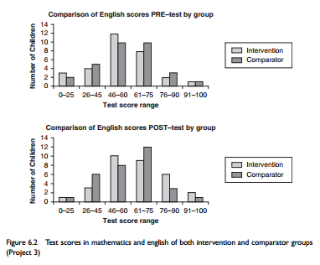
(Koshy 2010, p. 111)

